Slide 1
Kitchen Automation
GROUP MEMBERS
Sailee Angane
Arafaat Chaudhary
Rajat Bopalkar
Project Guide : Prof. Jaya Gupta

Slide 2
What is automation ?
Automation is a technology in which a process or a procedure is performed with minimal human assistance.
Term automation is inspired by the word “Automatic”, which means something which operates on its own.
Automation is achieved by various means including mechanical, hydraulics, pneumatic, electrical devices and computers, usually in combination.

Slide 3
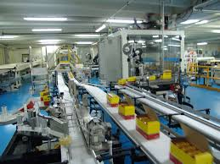
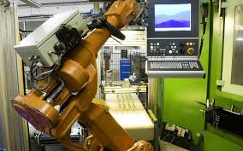
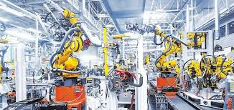
Applications of Automation.
Automation can be applied in various control systems such as machinery, processes in factories, boilers and heat treating ovens etc.
Automated Conveyor Belts
Automation in vehicle manufacturing.
Automated Robotic Arms

Slide 4
How is automation helpful ?
Automation helps in lessening the manpower to be invested in a particular task.
It simplifies the process and can be easily handled.
It is more reliable than the traditional procedure.
Convenient for working class to manage daily chores.
It requires no menial task performance.

Slide 5
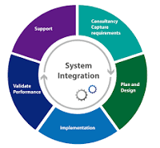
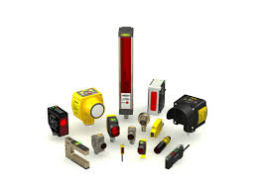
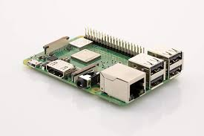

Technologies used in Automation.
Sensors: A device for measuring physical variable of an environment.
Central Processing Systems: A piece of a hardware which carries out instructions of a computer program.
Ui Path: An advanced tool which enables to design automation processes in a visual manner.
System integration is defined in engineering as the process of bringing together the component subsystems into one system.
Image Processing: Digital image processing is the use of computer algorithms to perform image processing on digital images.

Slide 6
Kitchen Automation
EGG TRAY AUTOMATION
JARS AND CONTAINER AUTOMATION
GAS AUTOMATION SYSTEM
This project includes four applications based on automation, which helps user in carrying out the kitchen related daily tasks conveniently and quickly without physically investing the manpower and time into the process.

Slide 7
Egg Tray Automation
Egg tray automation includes sensors within the egg trays, in which the eggs are to be kept.
A full egg tray will be considered as a target state for the application.
As the user will consume the eggs one by one, the sensor should detect the reduction of the product and update the information accordingly in the application.
As soon as the tray is empty, it would send the trigger to the user on the application either to fill the tray or to purchase the product.

Slide 8
Jars and container automation
This applications includes the weight sensors to each of the jar and the containers in which cereals, sugar etc are stored.
A full jar will be considered as the target state for the application.
A user will consume the stored product, sensor would detect the quantity consumed and update the information.
As soon as the jar becomes empty or reaches the minimal level the trigger will be sent to the user on the application to fill the jar.

Slide 9
Gas Automation System Part-1 (Gas Stove Control)
Gas Automation System would include a temperature sensors pointing at the utensils and a controlled mechanism connected to the burner handle.
The temperature sensor will monitor the temperature of the utensil. This sensor will send a trigger to turn off the burner when the maximum required temperature is achieved.
Burner will be automatically turned off after the trigger is sent. This automation would help us save gas by almost 30 to 40% while also providing required environment to cook food.

Slide 10
Gas Automation System Part-2 (Cooker Whistles)
In this application, we would be including a sound sensor near the cooker vessel and a controlled mechanism connected to the burner.
The user will define the number of whistles he wants to cook the food and the triggers will be set accordingly.
After the defined number of whistles are done, the gas burner should be automatically turned off.
This would help the user in a way that he won’t have to continuously keep on monitoring the cooker as we do, and can do some other work meanwhile saving time and efforts.

Slide 11
Benefits of Kitchen Automation.
No need of continuous monitoring on the tasks by the user. This will save time by only getting notified when the task is completed.
These automation systems will also help in saving the resources used in the kitchen and use them efficiently.
Taking manual safety measures won’t be a concerned issue anymore as the automation system and its sensors will help in ensuring there is no chance of a mishap.
The inventory of the kitchen will be efficiently managed as the user will be notified on prior the quantity of the kitchen material available at the current moment.
A very less amount of manpower will be required in the tasks.
User will be able to keep an eye on the daily activities and status while in busy in the work without actually being in the kitchen.

Slide 12
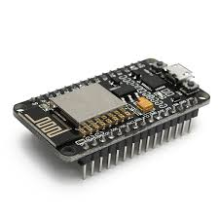
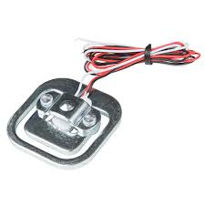
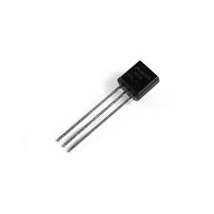
Technologies used in the project.
Weight sensors.
Temperature sensors.
Sound sensors.
Central Processing System : Node MCU.
Rotor Mechanism for control.
UI Application (Compatible with Android & iOS).

Slide 13
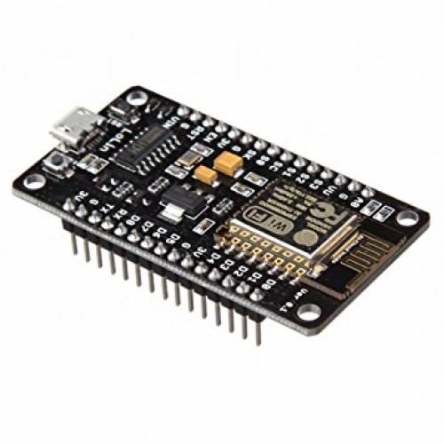
NODE MCU
NodeMCU(Micro Controller Unit) is an open source IoT platform.It includes firmware which runs on the ESP8266 Wi-Fi SoC from Espressif Systems, and hardware which is based on the ESP-12 module.The firmware uses the Lua scripting language.
Firmware can provide a standardized operating environment for the devices, acting as the device's complete operating system, performing all control, monitoring and data manipulation functions.
It has 16 GPIO pins. The device features 4MB of flash memory, 80MHz of system clock, around 50k of usable RAM and an on chip Wifi Transceiver.

Slide 14
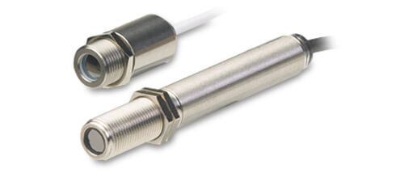
IR TEMPERATURE SENSOR
Infrared temperature sensors sense electromagnetic waves in the 700 nm to 14,000 nm range.
Because the emitted infrared energy of any object is proportional to its temperature, the electrical signal provides an accurate reading of the temperature of the object that it is pointed at.
IR sensors don’t wear. No contact means no friction. Infrared sensors experience no wear and tear, and consequently have longer operating lives.
IR sensors can provide more detail. An IR sensor can provide greater detail during a measurement than contact devices, simply by pointing it at different spots on the object being read.

Slide 15
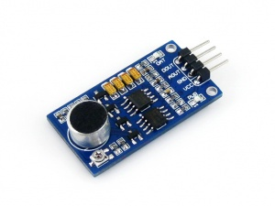
SOUND SENSOR
The Sound Detector is a small board that combines a microphone and some processing circuitry.
It provides not only an audio output, but also a binary indication of the presence of sound, and an analog representation of its amplitude
This Whistle Detecting method in which the circuit will detect for whistle. A whistle unlike other sounds will have a uniform frequency for a particular duration and hence can be distinguished from speech or music.

Slide 16
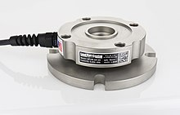
WEIGHT SENSORS
We will be using Pancake: low-profile load cells often used in vessel weighing; can be tension or compression.
A load cell is a type of transducer, specifically a force transducer. They convert a force such as tension, compression, pressure, or torque into an electrical signal that can be measured and standardized. As the force applied to the load cell increases, the electrical signal changes proportionally.

Slide 17
What all we did till now.
Our team members researched from the available sources and selected “Kitchen Automation”as the topic to implement practically.
IEEE papers were studied thoroughly in order to achieve a clear idea and the technical concept behind the project.
Based on the study, four kitchen automation applications were shortlisted which are to be implemented.
Appropriate User Interface implementation was researched and learning skills for the practical implementation is in progress.
Node MCU was made available and further hardwares are to be bought for integration.

Slide 18
At what stage are we right now.
Study of software developing languages and program applications is being carried on in order to build an UI.
Purchase of the hardware requirements, and selecting the correct and most efficient hardwares available.
Learning the implementation and configurations of Node MCU for practical implementation and how to integrate it with other hardwares.
How to build an interface between hardware and software via the Node MCU model and how to transfer and process the data.

Slide 19
How do we plan to move forward.
After getting the hardware part of the project right on its place, configuration of it will be done.
This configuration will be done in order to make it compatible with the user interface application.
Several testings and different methods will be applied to achieve the most efficient and user beneficial functioning of the whole system.

Slide 20
Expected final goal
A properly functioning kitchen automated system which will carry out all the tasks for which it is programmed.
All the four applications as explained, must be working in a proper manner.

Slide 21


